Slide 1
CST-361 Design Patterns in java CLC learning assignment
Grand Canyon University
Raymond Popsie
Timothy James
Stephan Moncavage
Notes:
This is a presentation for the CLC- Project assignment for CST-361 Design Pattern’s in Java
This presentation is the final Milestone for the project and will provide an overview of the program created by our group.

Slide 2
Project overview
Create an embedded application on Raspberry Pi that sends data to a central database.
Create functional web-based Java EE application which pulls data from the embedded application and shows data through RESTful services
The basis of this program is to allow users to use data from a database in order to populate a web-based application.
Notes:
The backbone of this project is Java EE, Python and other packages as well.
* = Presenter Notes (DO NOT SPEAK THESE DIRECTLY!)

Slide 3
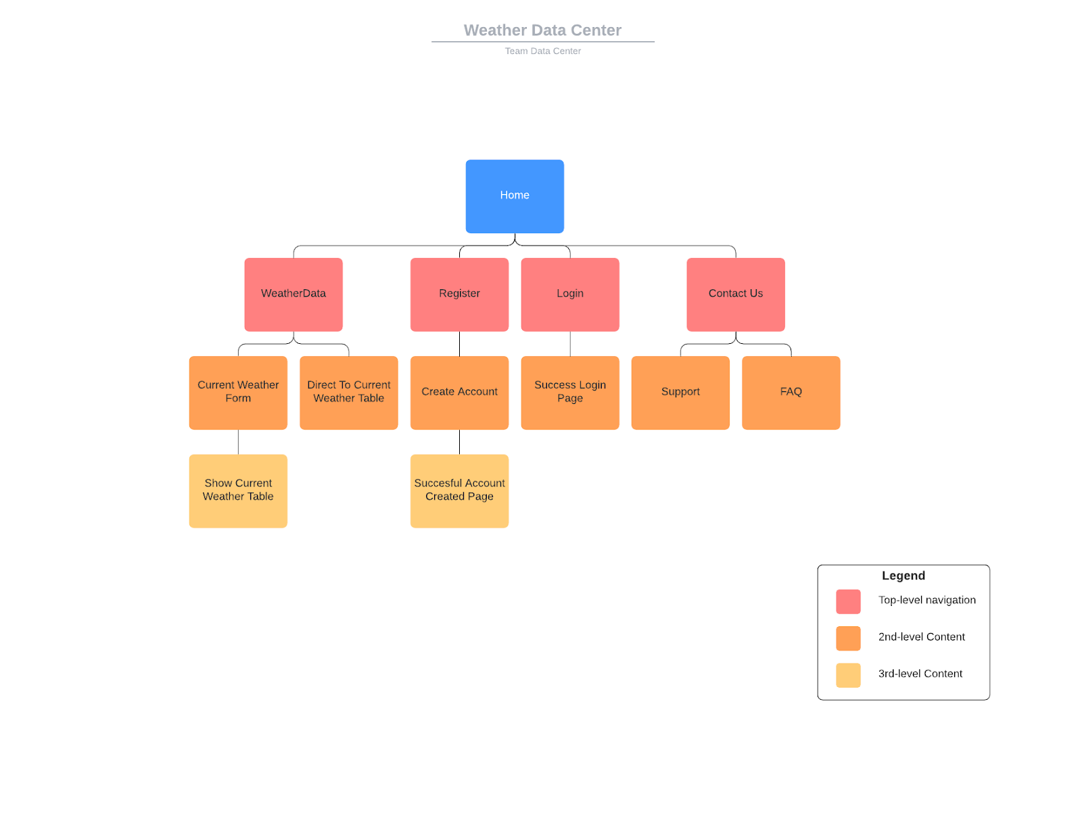
sitemap
Notes:
Here we have an overview of the program with the layout of the pages which render and what content is attributed to each page.
*List pages and content

Slide 4
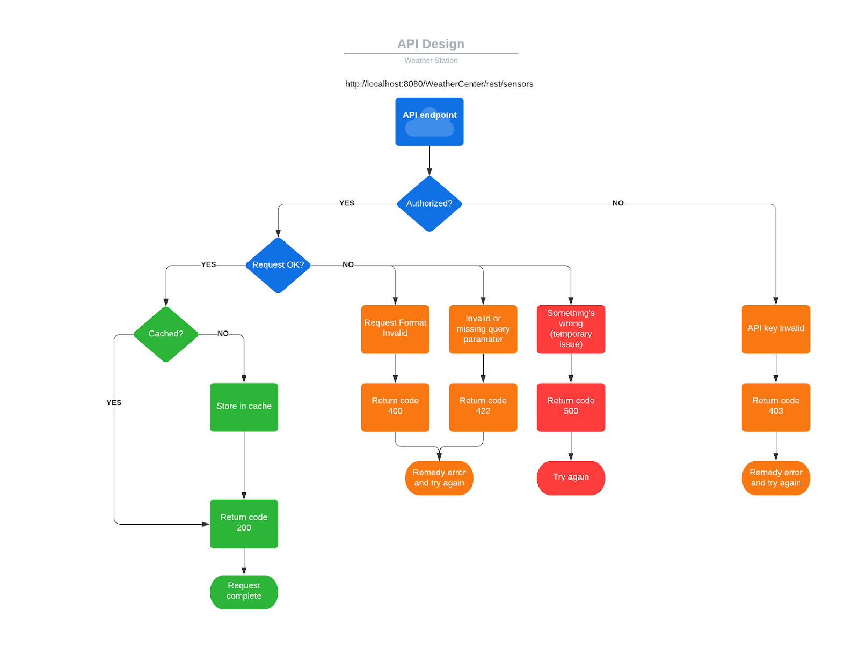
API Design Diagram:
Notes:
This slide contains the API Design Diagram which shows how the data and information produced by the webpage interact with each other.
*Walk through Diagram

Slide 5
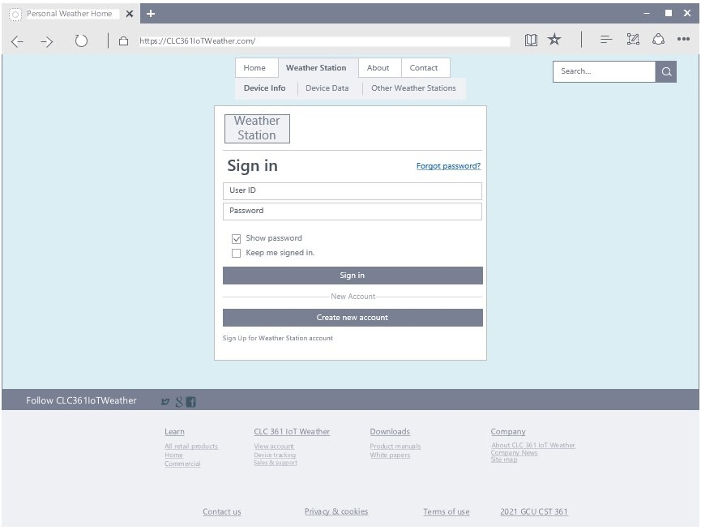
Login Web-frame

Slide 6
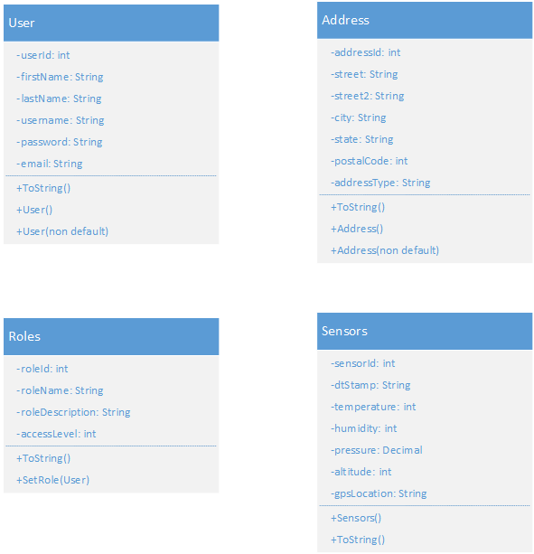
UML User ClAss Diagram:
Notes:
On this slide we can see the User Class UML used in the base code along with their attributes and content.
*Not shown here are the interfaces for the User, Login, and Registration modules, Point that out
And explain what how an “interface” reacts to the other portions of code.

Slide 7
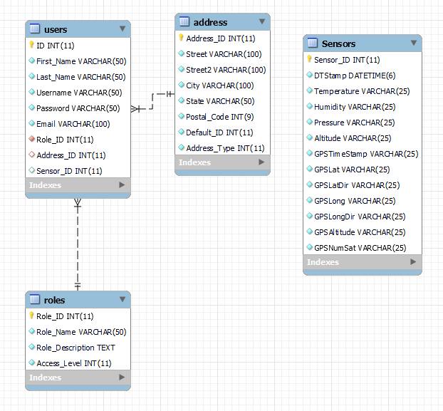
Entity Relational Diagram
Notes:
This slide contains the ER Diagram which shows how the data and information produced by the webpage interact with each other.
*Walk through Diagram

Slide 8
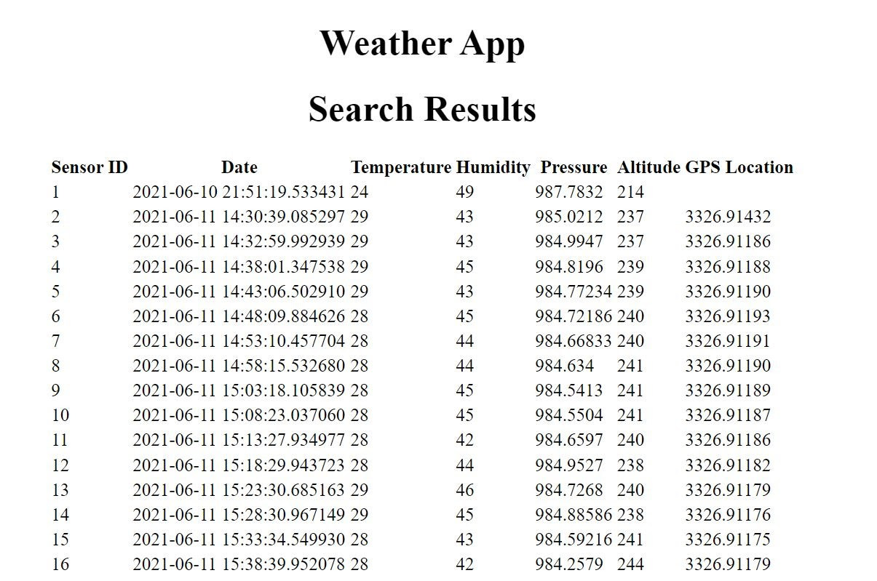
Data Results on Webpage
Notes:
This slide shows the data from the embedded application on the Raspberry Pi unit which was uploaded to a Database and then pulled into the web-base application.

Slide 9
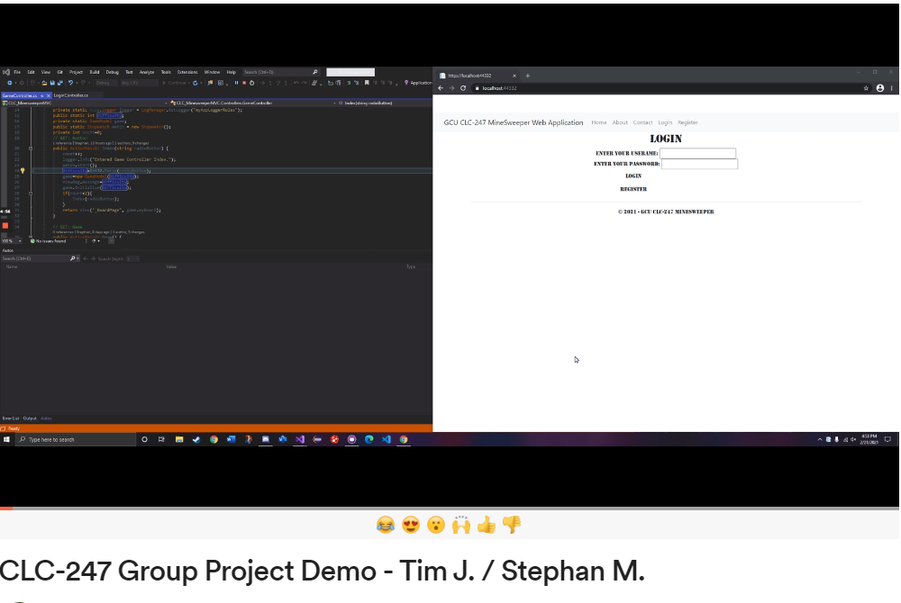
Video demonstration by: Tim James
Notes:
https://www.loom.com/share/4eb1a90e0581498198abc86d5b896eca
* Introduce the video and the link to webpage is above if having video issues.

Slide 10
Risks:
Risk | Details | Strategy for risk avoidance | Strategy for Mitigation
Project Expectations by Group | It is easy to over design or have designs which are outside the capabilities of the programmer to accomplish in the time given. It also may be unnecessary for the project to have useful functionality. | Use examples from the class, as well as what can be found on the internet to understand what is actually necessary for functionality. | We keep the scope tight and simple. This is about delivering a product by the end of the course. Every week the focus is to get the basic functionality working as requested by the syllabus.
Hardware | Potential computer problems may arise that halt development. | Make sure you have options in terms of development machine. Making sure your machines are in good condition | If you think you are going to have a hardware issue, or your machine does not have the minimum requirements to run the environments and tasks it may be time to upgrade or buy new components.
Time Allotted | We are only given a week to get work done for each sprint/CLC assignment. This is a short period of time and even with 3 programmers this could be not enough time. | Make a plan early to keep workflow going from week to week. Tell the team what is going on week to week. Plan early and hold meetings weekly. | A week can be a tight time frame to work in, so we need to keep on schedule. Every task needs to have a purpose, keeping tasks small and accomplishable helps the work to move faster. Don’t take on a task you cannot complete.
Education/Experience | Since not all of us have the same experience/education and knowledge, there will be differences and perhaps lacking skills that may be needed for this project week to week. | Let your team know what your education/experience level is. Sharing your weaknesses and strengths prior to being assigned a role or task week to week. | Not being the most knowledgeable person is nothing to be ashamed of, when your team knows your weakness and strengths, we can work around them and with them. Also, the team may be able to inform you on the topic and bring you up to speed.
Notes:
*Walk through the risks and highlight highs and lows of each as it pertains to the project

Slide 11
Risks Continued
Internet/Git | The internet could possibly go out for one of us, and that is detrimental to pushing code to GIT. Also, if GIT were to go down, we would not be able to share or access our working trees. | Make sure the internet is functional at your home, if it is not having a place you can go to that has internet for you to use. Pay bills ahead of time if necessary. | Keeping the bills paid early from month to month is a simple start. Make sure you pay attention to possible outages and have a backup place to go if yours does go down. Find a coffee shop that has free Wi-Fi, or a friend’s home that they will allow you to use. Watch to see if GIT notifies on outages or possible updates and changes.
Individual’s not fulfilling sprint tasks | Any one of the issues listed could work against us, but not being involved in the development process and getting the individually assigned work done hurts the team. | Keeping each other accountable for the work needed to be done. Making sure we mark off tasks and stay in communication. | Stay on task, this is not about an individual grade, we are in this together. If you are going to need some slack for the week let the team know and we can work something out. It may even be possible to get extensions if we can let the instructor know about something going on.
New skills needed to complete tasks | Since we are all in school, it is assumed we all have something to learn. Be it the environment, language or process. There is a learning curve attached to them all and everyone has to be diligent in trying to learn in a timely manner. | If there is something, we need to learn in order to get the tasks for the week done, let the team know as soon as possible. | Look at your tasks during the weekend prior to the start of the sprint, knowing what you have to work on early can let you know if you need to study and read prior to starting the sprint or before planning. Asks about potential resources and keep known ones favorite in your browser.
Notes:
*Walk through the risks and highlight highs and lows of each as it pertains to the project

Slide 12
Risks Continued
Tool failure | The tools we are using could fail. It is not likely and low risk, but anything that can go wrong, will. | Keep up to date with the environments, have everything loaded, and play with the environment ahead of development. | This may be unavoidable if it does happen. However, keep your environment up to date, and make sure they are installed correctly. If you run into an issue, ask the team how they are set up to avoid it.
School Assignments | Since we are having to learn these skills as we go, and have individual assignments with no direct instruction, the individual assignments take longer than in other courses. This takes more time for us to work on, and pushes project development back | Starting work earlier in the week helps to buy some extra time towards the end of the week. | Long term getting ahead and keeping to the overall set schedules will help to buy back time.
Work | Some of us work full time, and or part time, that consumes a majority of the day and an individual’s energy. Class is added pressure to someone who works, and class is secondary to making a living, if someone has to choose between making a grade and paying bills it’s obvious what someone will choose. | Keeping a schedule to separate work from school, to avoid burnout. Let your boss know that you are in school and the scope of the project being taken on to complete the course. | Let the team know if you have a job. Plan out your week for yourself, and do not wait till the end of the week to work on your portion. Inform your boss that you may need a lighter workload if you need work time to get things done.
Notes:
*Walk through the risks and highlight highs and lows of each as it pertains to the project

Slide 13

Questions
Source - http://www.freedigitalphotos.net
Notes:
*Ask audience for questions and respond.

Slide 14
Review
Overview
Sitemap
Program Design UML
Program Functionality
Risks
Notes:
This was a limited scope of work to stay within the course timeframe and constrained to use functionality dictated by the frameworks and languages used.
Given another 4-6 weeks of development this program could become a real-world useable program which would allow users to carryout the functionality intended of uploading and sharing music content, videos, as well as artwork.
This would be achieved through the Data Modules within the code with an additional database tables for the actual music content and artwork. We hope that you have enjoyed our program as well as its design concepts and layout. Thank you!

Slide 15
References
Ardalis. (n.d.). Common web application architectures. Retrieved January 01, 2021, from https://docs.microsoft.com/en-us/dotnet/architecture/modern-web-apps-azure/common-web-application-architectures
ASP.NET MVC Tutorial. (n.d.). Retrieved January 03, 2021, from https://www.tutorialspoint.com/asp.net_mvc/index.htm
ASP.NET Razor C# Syntax. (n.d.). W3 Schools. Retrieved January 19, 2021, from https://www.w3schools.com/asp/razor_syntax.asp
Dotnet-Bot. (n.d.). .NET API browser. Retrieved January 03, 2021, from https://docs.microsoft.com/en-us/dotnet/api/
Drumond, C. (n.d.). Scrum - what it is, how it works, and why it's awesome. Retrieved January 01, 2021, from https://www.atlassian.com/agile/scrum
Friedman, J. (2016, June 07). ADO.NET Tutorial. Retrieved January 03, 2021, from http://csharp-station.com/Tutorial/AdoDotNet
Galloway, J., Wilson, B., Allen, K. S., & Matson, D. (2014). In Professional ASP.NET MVC 5 Indianapolis, IN: John Wiley & Sons.
Matskas, C., & Marsh, K. (2020, December 18). Channel 9 provides videos for developers, delivered by the people who work behind the scenes at Microsoft. Retrieved January 03, 2021, from https://channel9.msdn.com/On-NET/What-is-MSAL--MicrosoftIdentityWeb
Patel, P. (2014, February 24). Three Layer Architecture in C# .NET. Retrieved January 01, 2021, from https://www.codeproject.com/articles/36847/three-layer-architecture-in-c-net-2
Rawat, A. (n.d.). Dependency injection in c#. Retrieved February 18, 2021, from https://www.c-sharpcorner.com/UploadFile/85ed7a/dependency-injection-in-C-Sharp/#:~:text=Dependency%20Injection%20helps%20to%20reduce,instead%20of%20design%20time%20technically.
Schwaber, K., & Sutherland, J. (2020, November 18). The 2020 Scrum GuideTM. Retrieved January 01, 2021, from https://www.scrumguides.org/scrum-guide.html
ShoJaee, H. (2012, February 20). Intro to Scrum in Under 10 Minutes. Retrieved January 01, 2021, from https://www.youtube.com/watch?v=XU0llRltyFM
SQL - Create Tables. (n.d.). Retrieved January 03, 2021, from https://www.tutorialspoint.com/t_sql/t_sql_create_tables.htm
Stein, S., Schonning, N., Coulter, D., Sherer, T., & Warren, G. (2017, March 30). Code examples - ADO.NET. Retrieved January 03, 2021, from https://docs.microsoft.com/en-us/dotnet/framework/data/adonet/ado-net-code-examples
Zhelev, D. (2020, September 08). The Role of Layers in Web Applications. Retrieved January 01, 2021, from https://mentormate.com/blog/the-role-of-layers-in-web-applications/

